Slide 1



Generative AI with LLM
Florian Bastin
👨🏼‍🎓 Master MASH - Université PSL
👨🏼‍💻 LLM Engineer @OctoTechnology
Le Monde, Casino, Channel, Club Med, Pernod Ricard, Suez

Slide 2
III. Retrieval Augmented Generation
Basic Architecture
Information retrieval
Vectorstore & Search optimization
RAG Techniques
Evaluation
Multimodal RAG
SOTA RAG architectures

Slide 3
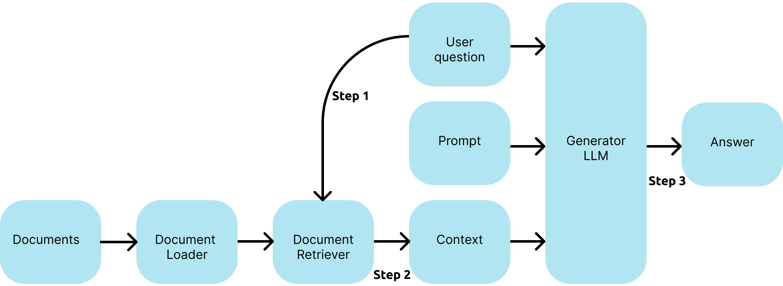
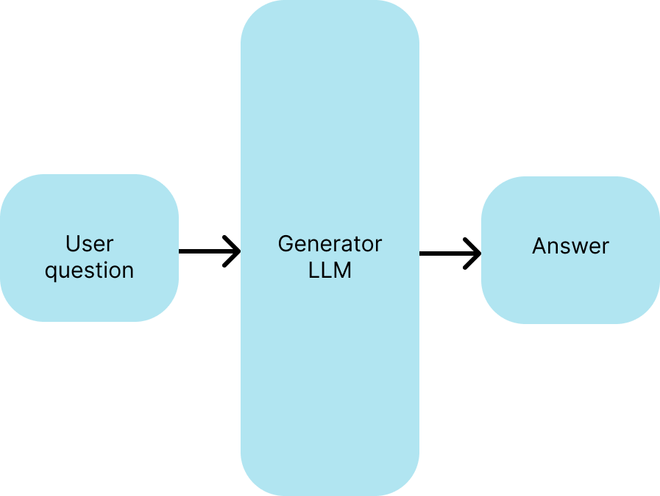
III. Introduction
LLM vs RAG
RAG
LLM

Slide 4
III. Introduction
RAG Definition
Definition: Retrieval-Augmented Generation (RAG) is a framework that combines retrieval-based and generation-based models. It enhances the capabilities of language models by providing them with access to external knowledge bases or documents during the generation process. This allows the model to generate more accurate and up-to-date information by retrieving relevant data instead of relying solely on its internal parameters.
Benefits:
• Produces more informed and factual responses.
• Can handle queries about recent events not present in the training data.
• Reduces hallucinations common in language models.

Slide 5
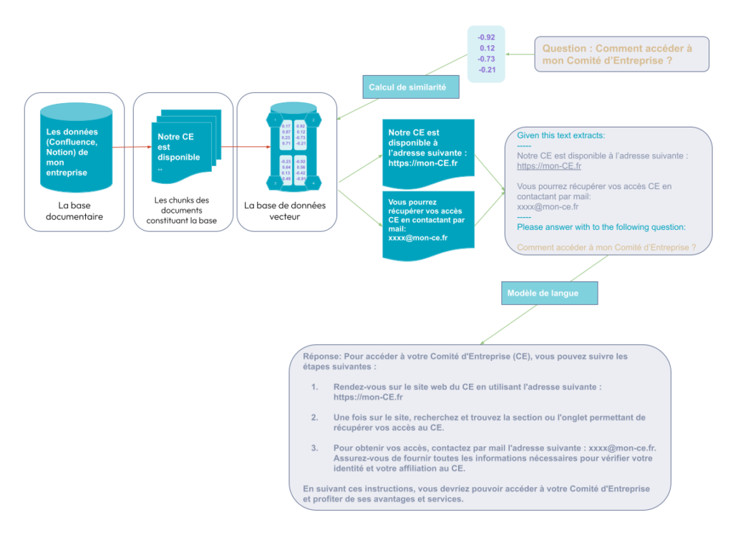
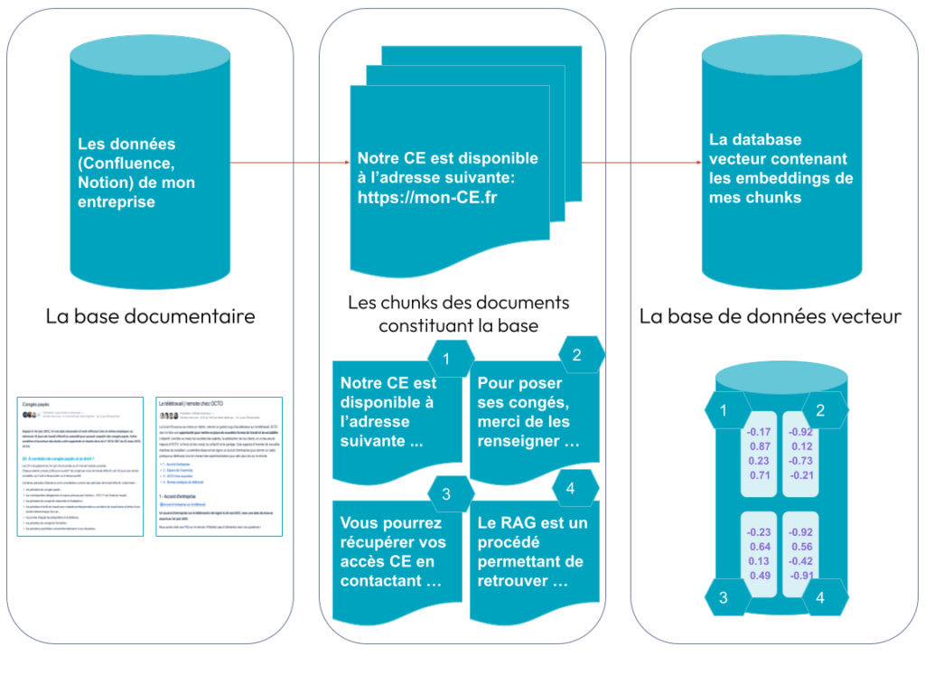
III.1. Basic Architecture
RAG Architecture
Step 1: Document ingestion
Step 2: Contextualized answering
Construire son RAG (Retrieval Augmented Generation) grâce à langchain: L’exemple de l’Helpdesk d’OCTO

Slide 6
III.1. Basic Architecture
RAG Architecture

Slide 7
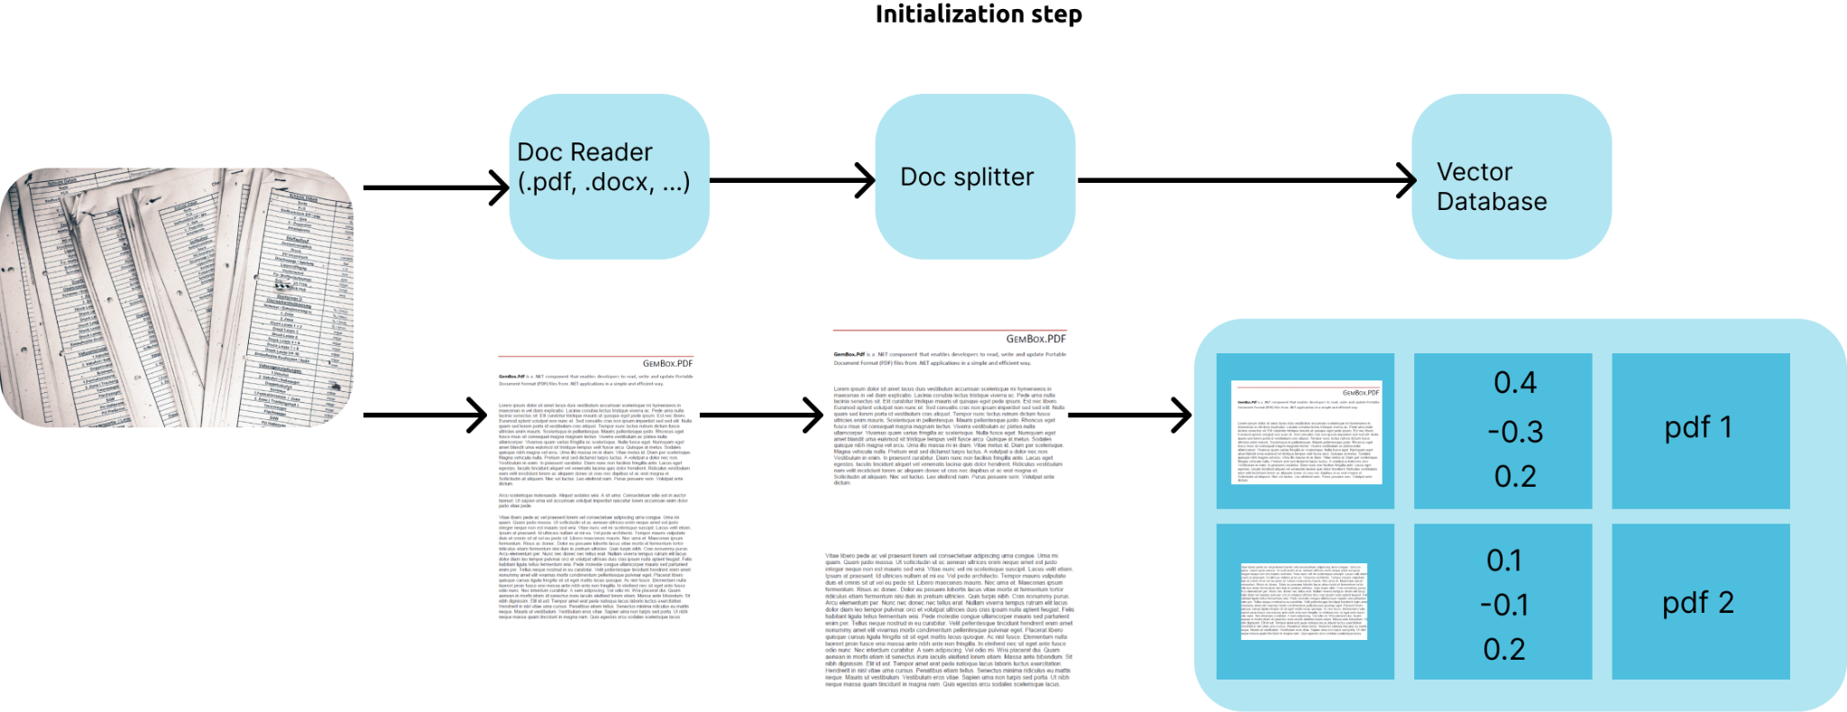
III.1. Basic Architecture
RAG Architecture

Slide 8
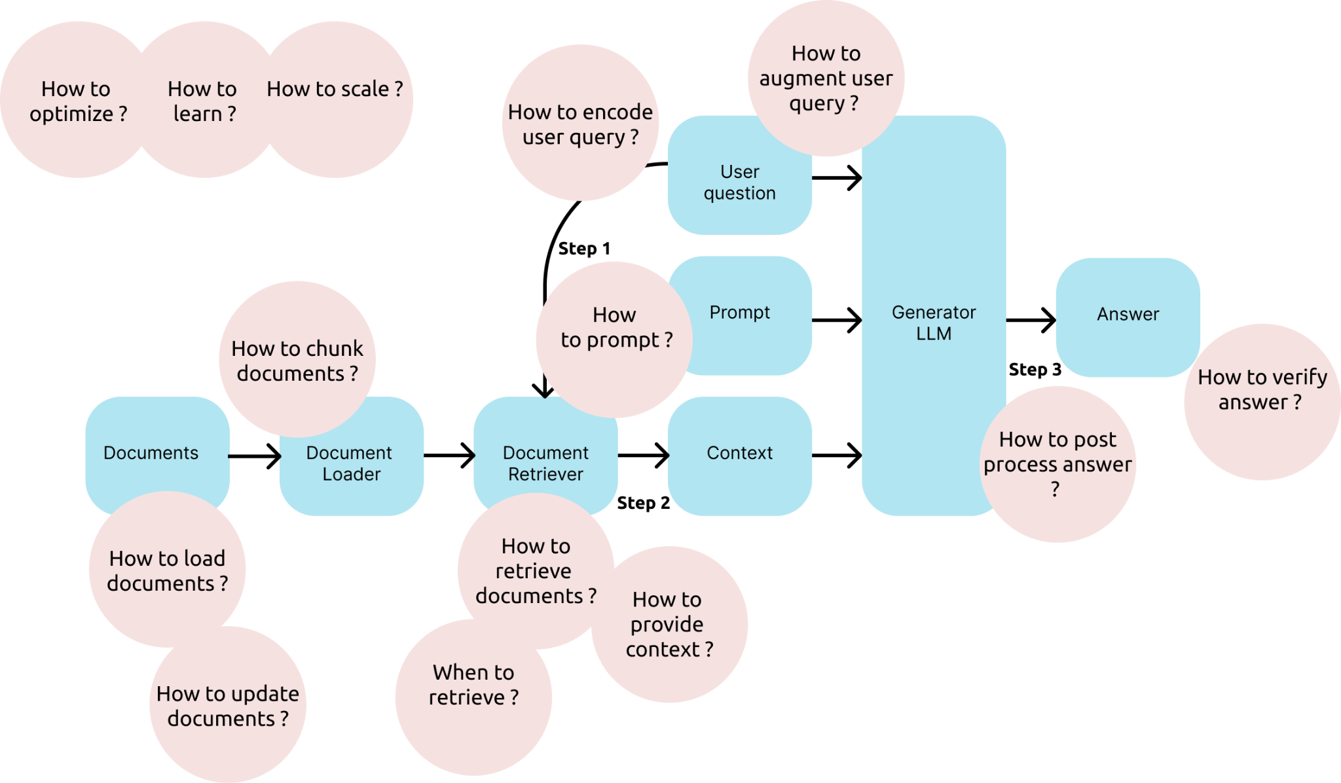
III.1. Basic Architecture
How to ?

Slide 9
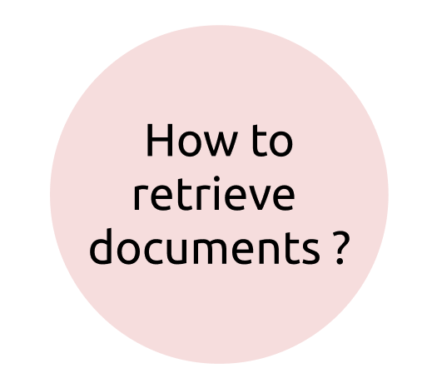
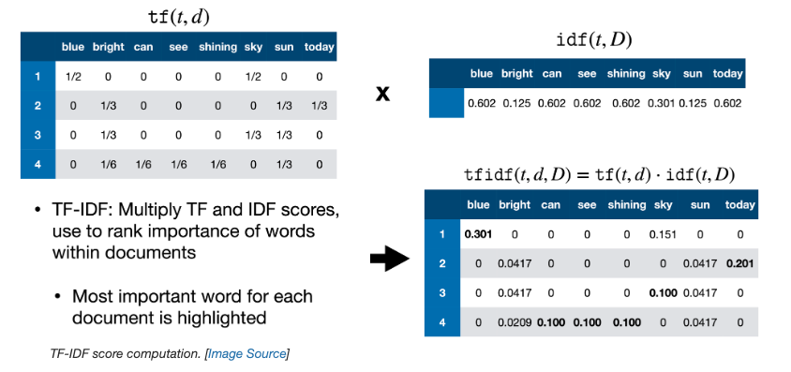
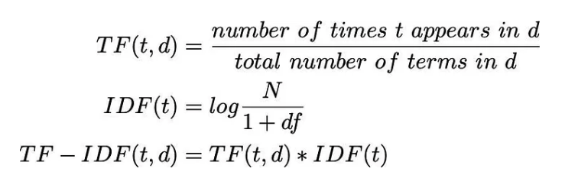
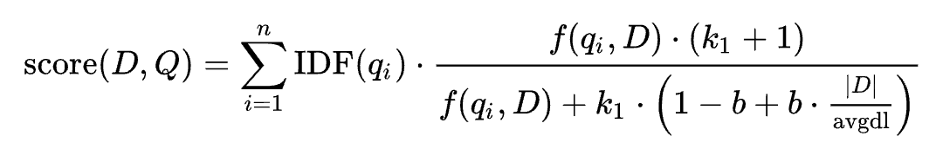
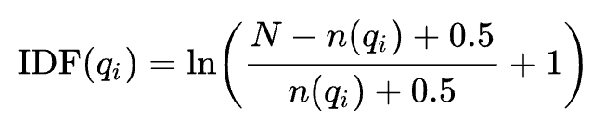
III.2. Information retrieval
TF-IDF
Given a query Q, containing keywords {q₁, …, q_{n}}, the BM25 score of a document D is:
BM 25
f(qi,D) is the number of times that the keyword qi occurs in the document D,
|D| is the length of the document D in words
avgdl is the average document length in the text collection from which documents are drawn.
K₁ and b are free parameters, usually chosen, in absence of an advanced optimization, as K₁∈[1.2,2.0] and b=0.75
N is the total number of documents in the collection, and
n(qi) s the number of documents containing q_{i}
Text Search using TF-IDF and Elasticsearch

Slide 10
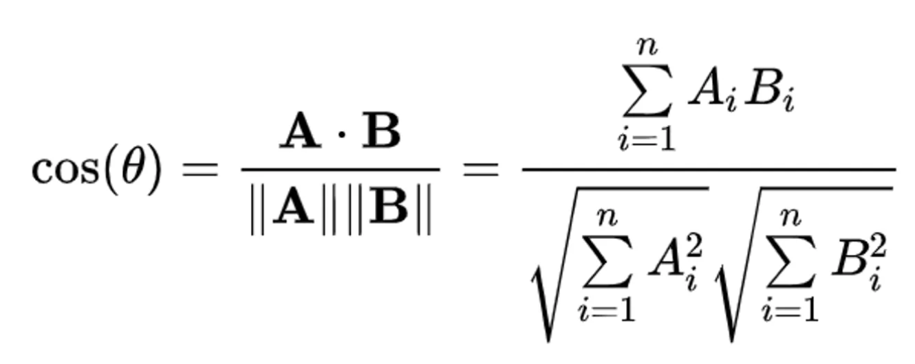
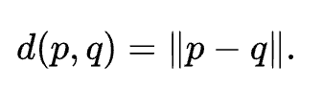
III.2. Information retrieval
Cosine Similarity
Euclidean distance

Slide 11
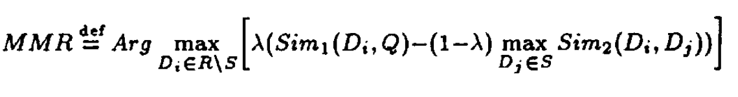
III.2. Information retrieval
Maximal Marginal Relevance
The goal of this metric is to retrieve dissimilar documents and increase diversity
D is the set of all candidate documents, R is the set of already selected documents, q is the query
Sim₁ is the similarity function between a document and the query
Sim₂ is the similarity function between two documents.
di and dj are documents in D and R respectively
The parameter λ (mmr_threshold) controls the trade-off between relevance (the first term) and diversity (the second term). If mmr_threshold is close to 1, more emphasis is put on relevance, while a mmr_threshold close to 0 puts more emphasis on diversity.
The Use of MMR, Diversity-Based Reranking for Reordering Documents and Producing Summaries

Slide 12
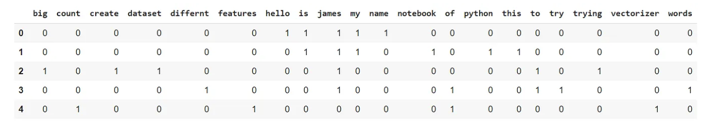
III.2. Information retrieval
Sparse vs Dense retrieval
Sparse embedding (lots of 0)
Sparse Retrieval (TF IDF, BM 25, …) are methods to retrieve similar documents based on keywords only.
Dense Retrieval (Cos Sim, Euclidean distance) allows to retrieve document using semantic embedding representation of documents and query.
Hybrid Search is a method involving both sparse and dense retrievers to provide both advantages of the two approaches
Q. If I want to retrieve document based on the user query ‘LeCun Meta’, what kind of retriever do I use ?
Q. If I want to retrieve document based on the user query ‘What are the most wonderful shots of Lebron James ?’, what kind of retriever do I use ?
Q. If I want to retrieve document based on the user query ‘What is the capital city of the biggest city in the world ?’, what kind of retriever do I use ?

Slide 13
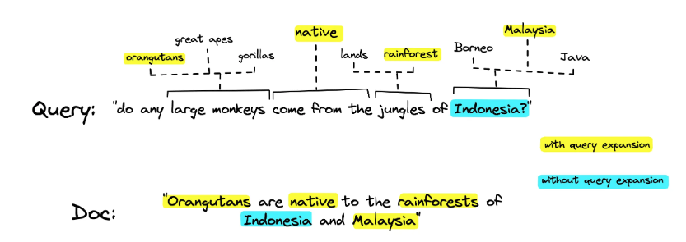
III.2. Information retrieval
Sparse Lexical and Expansion (SPLADE)
Vector database are super efficient compare to Splade at the moment
With sparse methods, you cannot get synonyms from a words.
SPLADE:
Use Bert to get similar words like synonyms
Provide these synonyms to a sparse methods
SPLADE for Sparse Vector Search Explained
Formal & Al, 2021, SPLADE V2

Slide 14
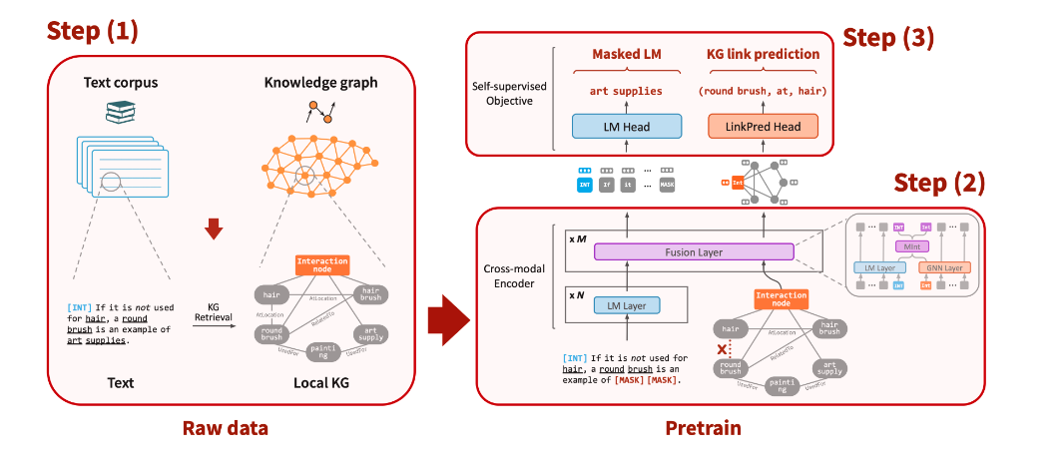
III.2. Information retrieval
Deep Bidirectional Language-Knowledge Graph Pretraining (DRAGON)
Dense retriever
Progressive Data Augmentation strategy for training sampling very difficult negatives
Lin & Al, 2023, How to Train Your DRAGON
Yasunaga, 2023, DRAGON: Training a Foundation Model from Text and Knowledge Graph [Blog]
Notes:
We first sample pairs of text segments and relevant KG subgraphs to create inputs for the model (Step 1). We then use a deep bidirectional model to fuse the input text and KG (Step 2), and finally pretrain the model using a joint self-supervised task over the two modalities (Step 3).

Slide 15
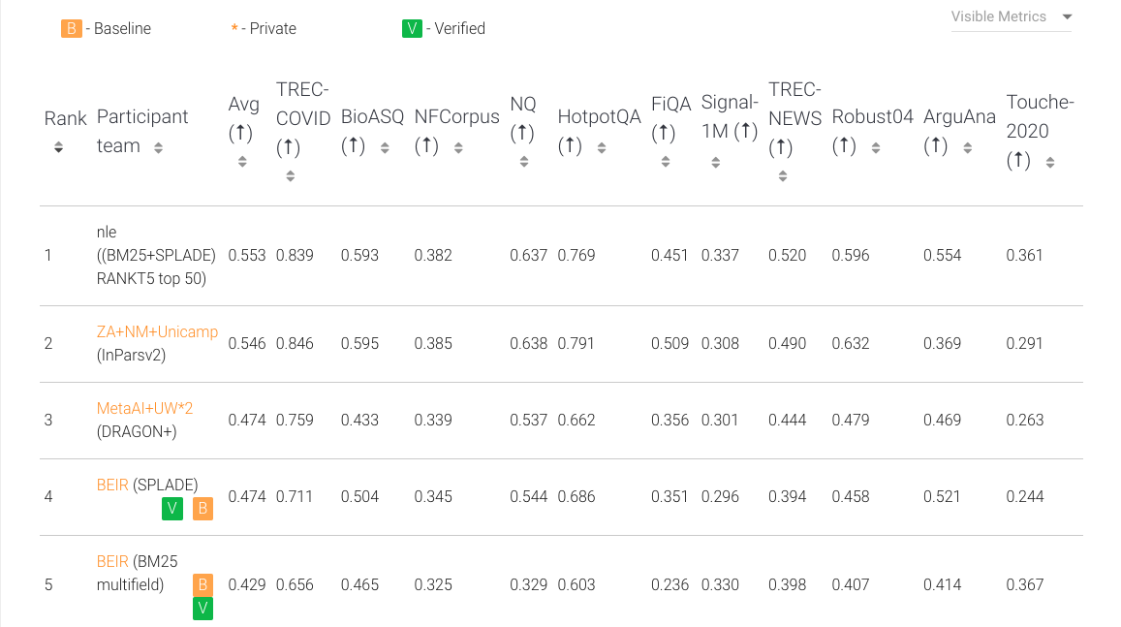
III.2. Information retrieval
Best retrieval methods
Leaderboard for best Information Retrieval methods: https://eval.ai/web/challenges/challenge-page/1897/leaderboard/4475

Slide 16
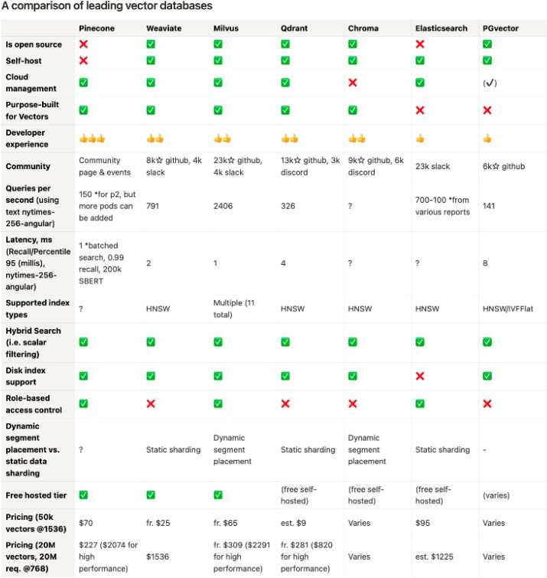
III.3. Vectorstore & Search optimization
Vector Database
Definition: A vector database is a specialized database designed to store, manage, and query high-dimensional vector embeddings of data such as text, images, or other content types.
These embeddings are numerical representations produced by machine learning models that capture the semantic meaning of the data.
Vector DB Comparison

Slide 17
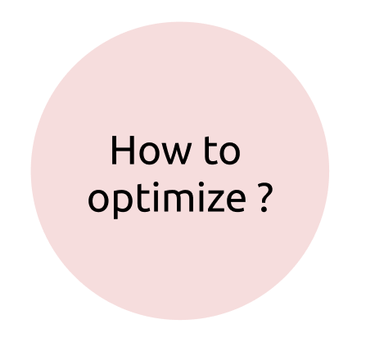
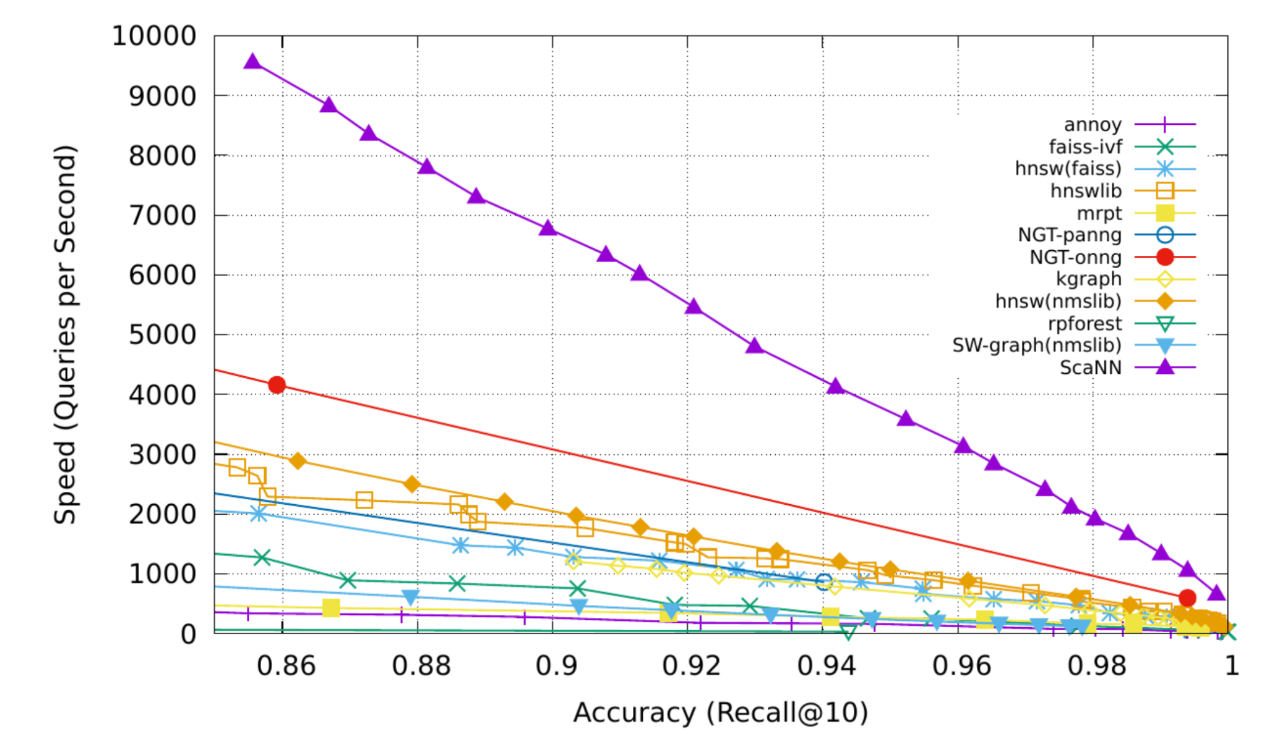
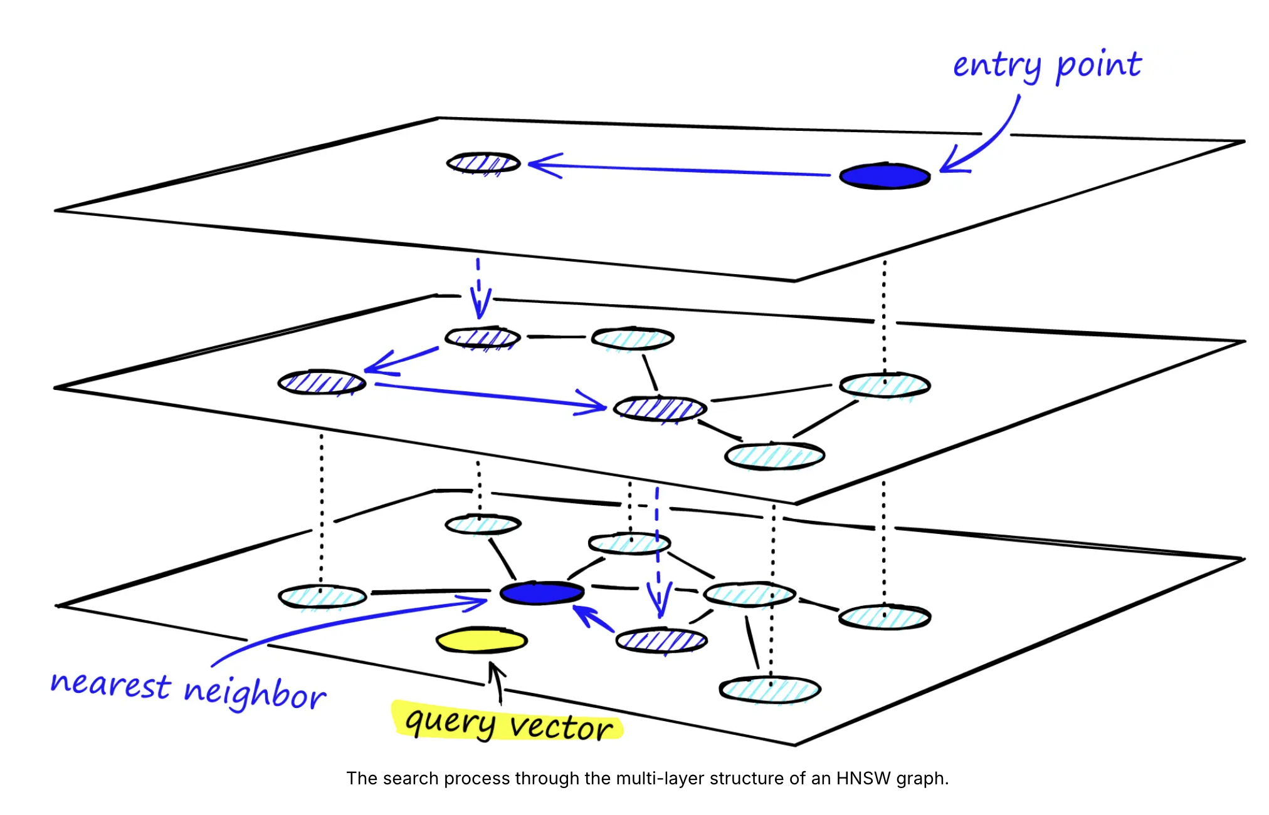
III.3. Vectorstore & Search optimization
Efficient similarity search
Scalable Nearest Neighbors (ScaNN) - Google
Facebook AI Similarity Search (FAISS)
Hierarchical Navigable Small Worlds (HNSW)
Definition:
ScaNN, FAISS and HNSW are methods for retrieving similar embeddings based on vector quantization and ANN search instead of full scan search.
Announcing ScaNN: Efficient Vector Similarity Search
Hierarchical Navigable Small Worlds (HNSW) [Blog]

Slide 18
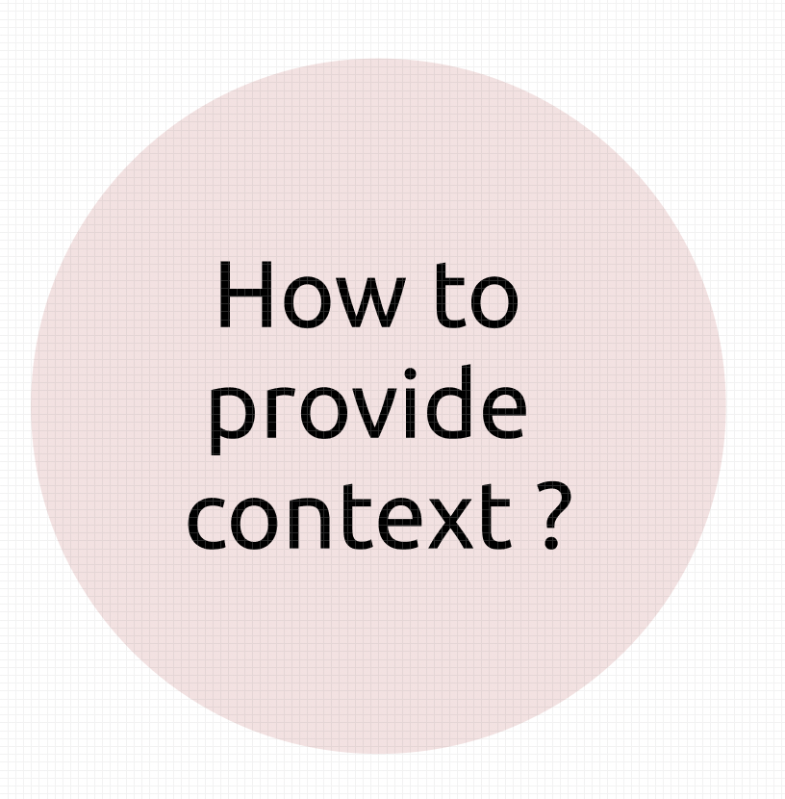
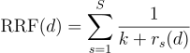
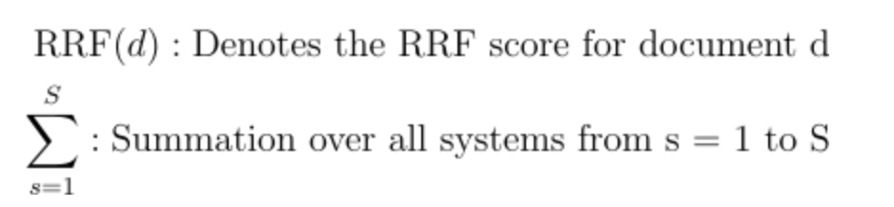
III.3. Vectorstore & Search optimization
Reciprocal Rank Fusion (RRF)
Definition:
RRF allows to merge results of different retrievers

Slide 19
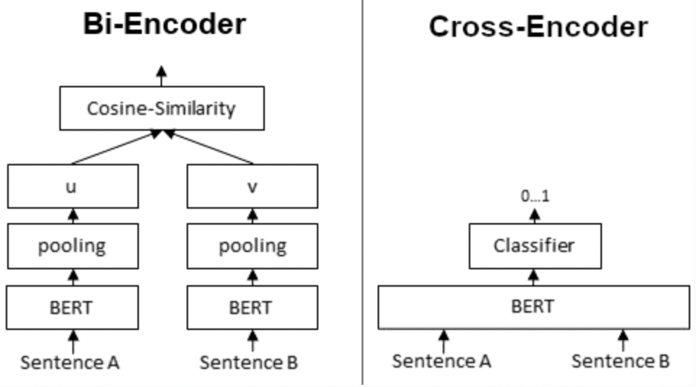
III.3. Vectorstore & Search optimization
Reranker
A reranker ranks retrieved documents after a first similarity search
Reranker type:
Cross-Encoders
Neural Rerankers
Benefits of Using a Reranker:
Increased Accuracy: Improves the likelihood that the most relevant information is used in generating the response.
Better Contextual Understanding: Helps the system understand subtle nuances in the query.
Challenges:
Computational Overhead: Additional processing can increase response time.
Resource Intensive: Advanced models require significant computational resources.
Bi Encoder vs Cross Encoder

Slide 20
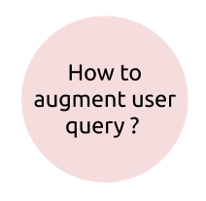
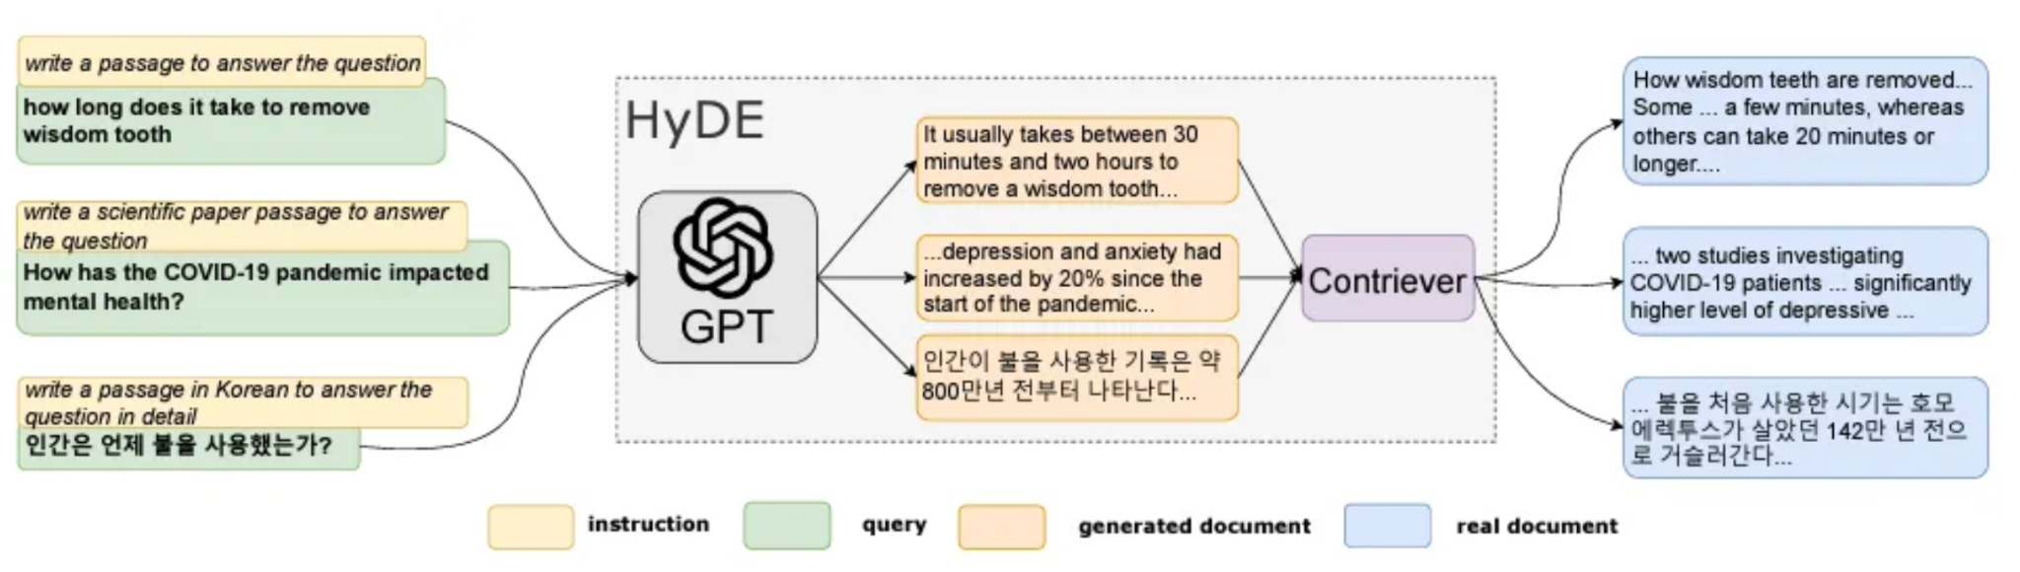
III.4. RAG Techniques
Query augmentation
Definition: query augmentation refers to the process of enhancing or expanding the user’s original query to improve the retrieval of relevant documents or information from a knowledge base.
By augmenting the query, the system aims to retrieve more comprehensive and pertinent data, which can then be used to generate more accurate and informative responses.
HyDE: Generate a fake answer from a query to improve information retrieval
Luyu Gao & Al, 2022 Precise Zero-Shot Dense Retrieval without Relevance Labels

Slide 21
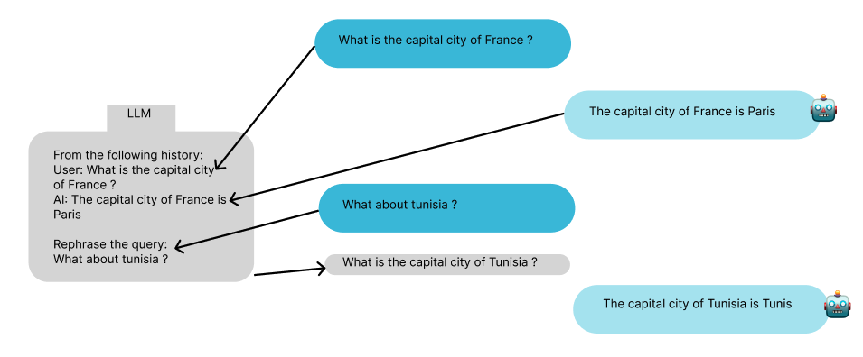
III.4. RAG Techniques
Query rephrasing
Query rephrasing can be used to rephrase the query from the conversation history

Slide 22
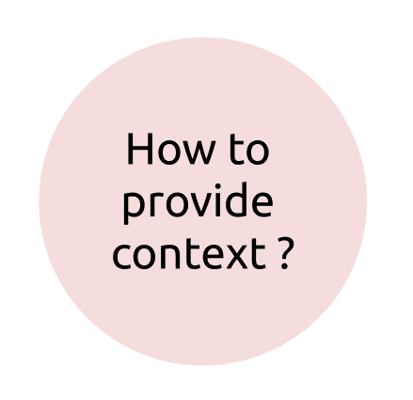
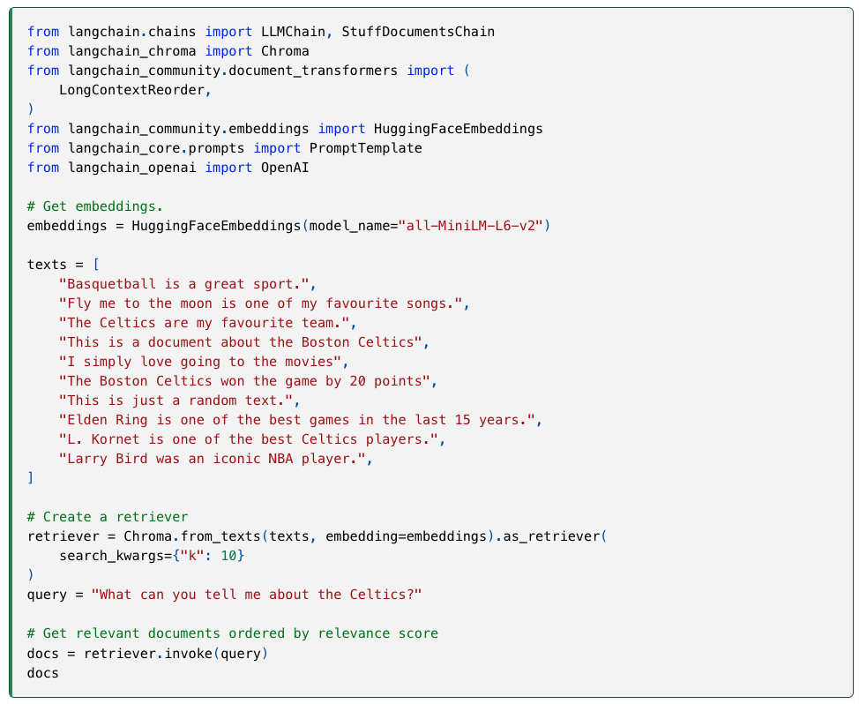
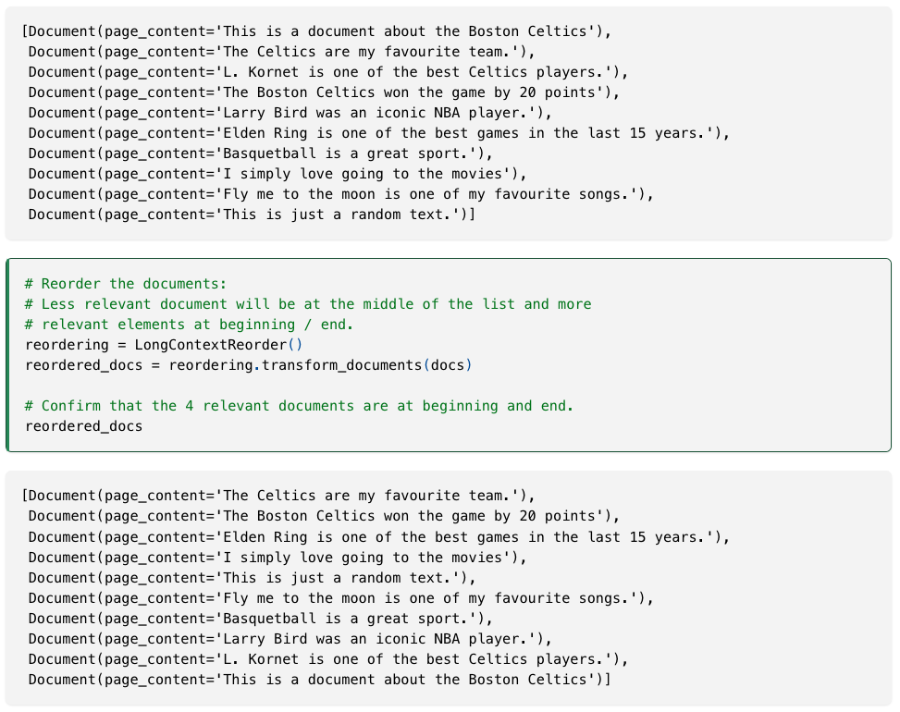
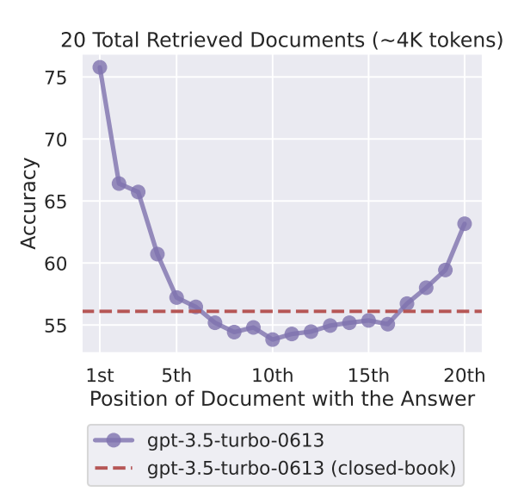
III.4. RAG Techniques
Lost In the Middle
Retrieved context provided at the beginning or the end of the prompt have more impact on the answer
LangChain, Long Context Reorder [Blog]
F. Liu & Al, 2023, Lost in the Middle: How Language Models Use Long Contexts

Slide 23
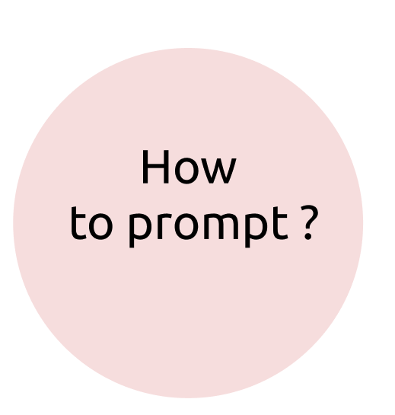
III.4. RAG Techniques
Prompt Engineering
Write clear instructions
Provide reference text
Split complex tasks into simpler subtasks
Give the model time to "think"
Use external tools (RAG)
Tactic:
Ask the model to adopt a persona
Use delimiters to clearly indicate distinct parts of the input
Specify the steps required to complete a task
Provide examples
Specify the desired length of the output
Open AI, Prompt engineering

Slide 24

III.4. RAG Techniques
Document Loader
Load any type of document (PDF, PPT(x), DOC(x), XLS(x)
Unstructured: https://unstructured.io/
LLama Parse: https://llamahub.ai/l/readers/llama-index-readers-llama-parse?from=readers

Slide 25
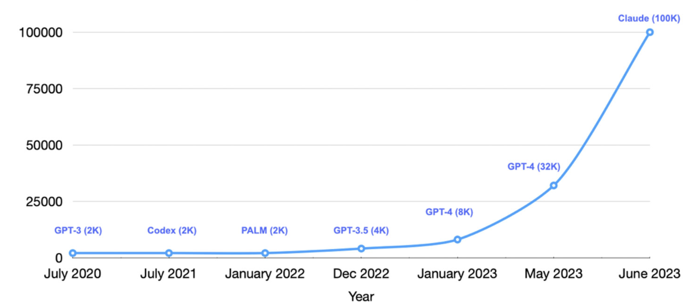
III.4. RAG Techniques
Context
Definition: The context size refers to the maximum number of tokens (words or subword units) that the model can process in a single input sequence. It determines how much textual information the model can consider at once when generating responses or predictions.
A larger context size allows the model to capture longer dependencies and understand more extensive context within the input, leading to more coherent and relevant outputs.
A smaller context size limits the amount of information the model can utilize from the input text.
Variable Sequence Length Training for Long-Context Large Language Models

Slide 26
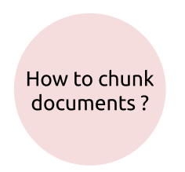
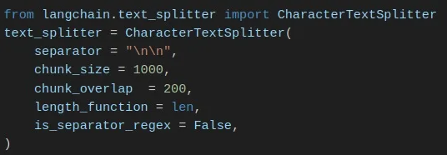
III.4. RAG Techniques
Chunking
To avoid context limitations, we can do document chunking:
Chunk by document if the document is small
Chunk by title or header if the document is big
Announcing ScaNN: Efficient Vector Similarity Search

Slide 27
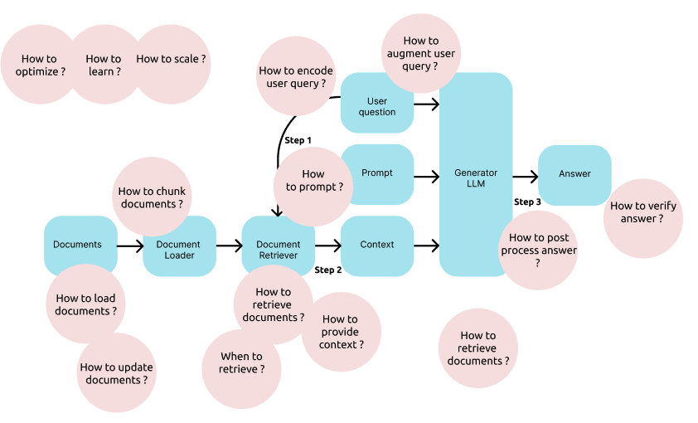

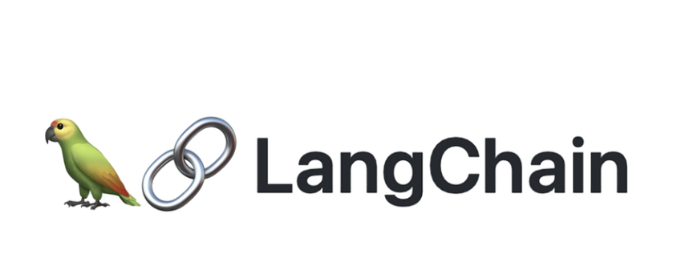
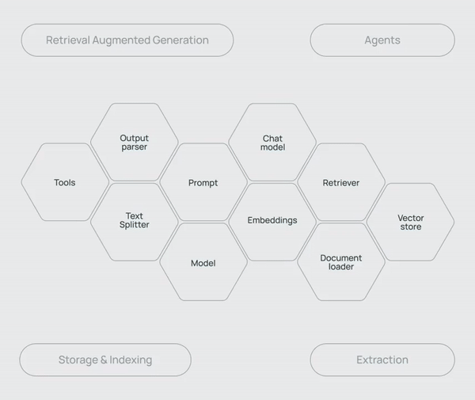
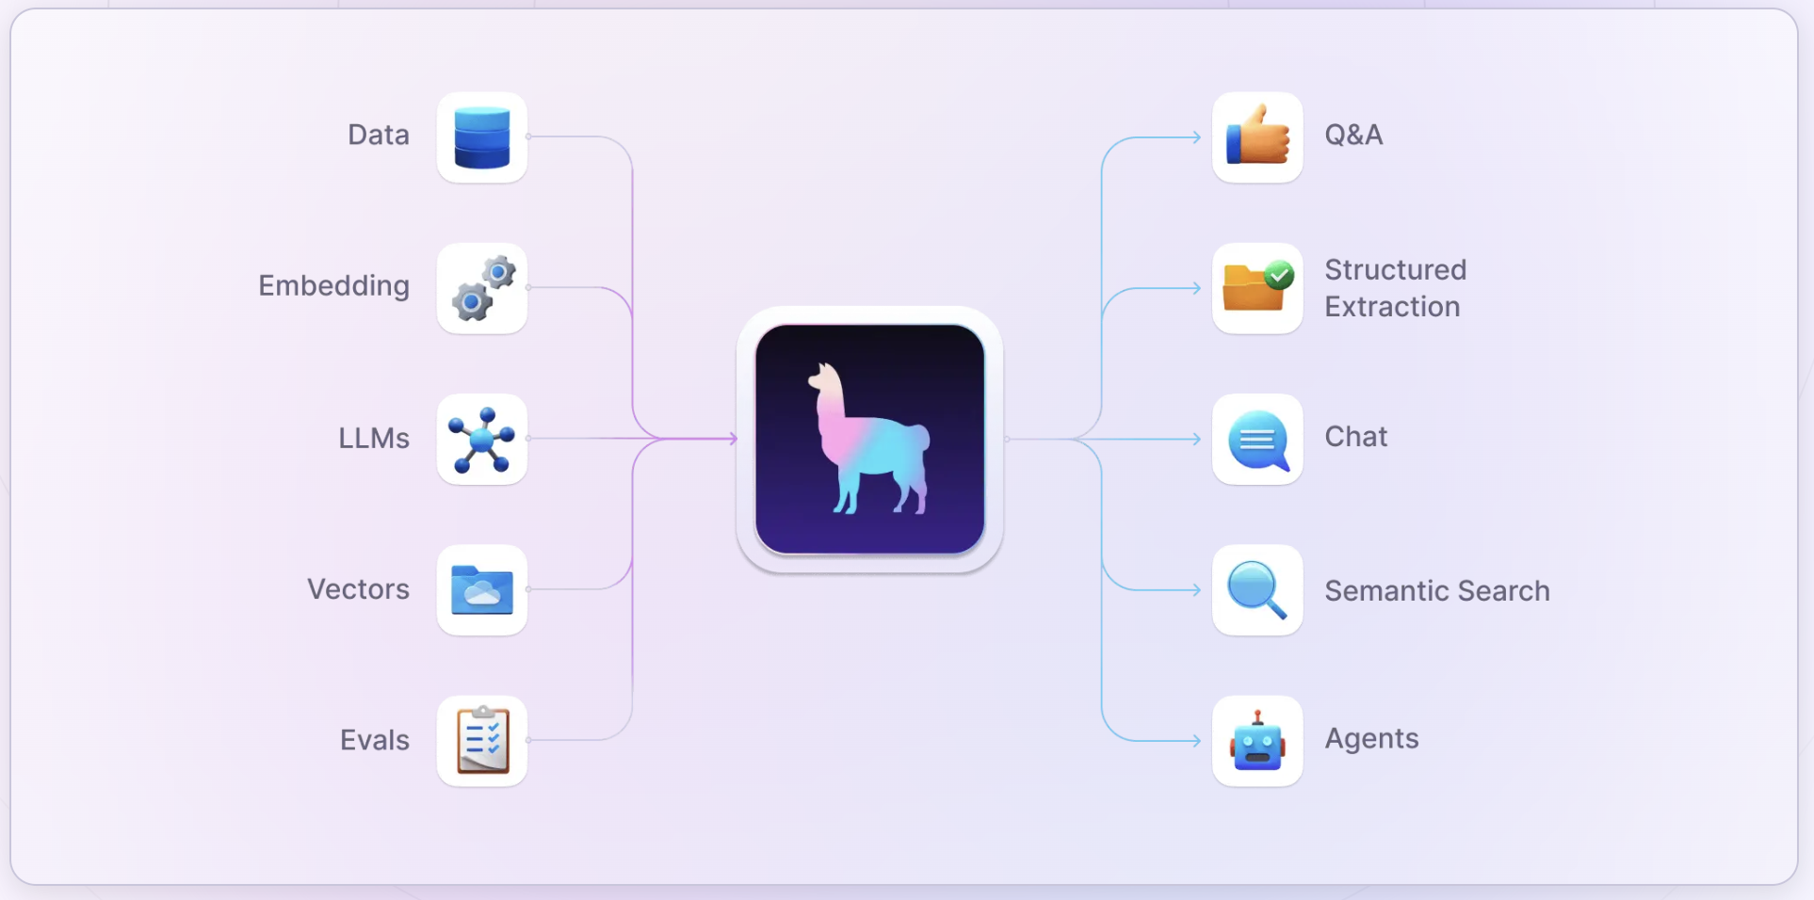
III.4. RAG Techniques
RAG Frameworks in Python
Langchain
LlamaIndex
Notes:
Le plus un doc importnat est bas le moins il a de poids
IDCG est le parfait ranking

Slide 28
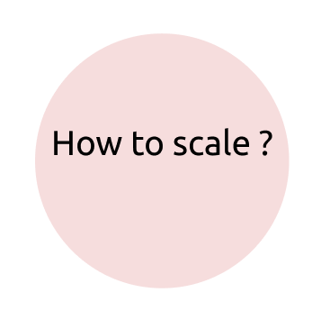
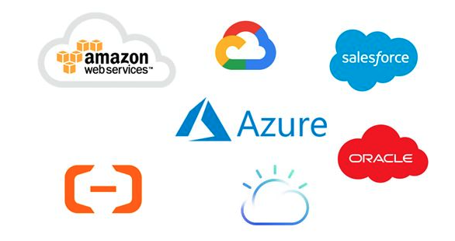
III.4. RAG Techniques
Cloud services
Cloud Services provide:
A Secure environment
Enough compute to train big models
Product as a Service (PaaS)
LLMs APIs
Vector Store management
Efficient Retrieval
Monitoring tools
…
Notes:
Le plus un doc importnat est bas le moins il a de poids
IDCG est le parfait ranking

Slide 29
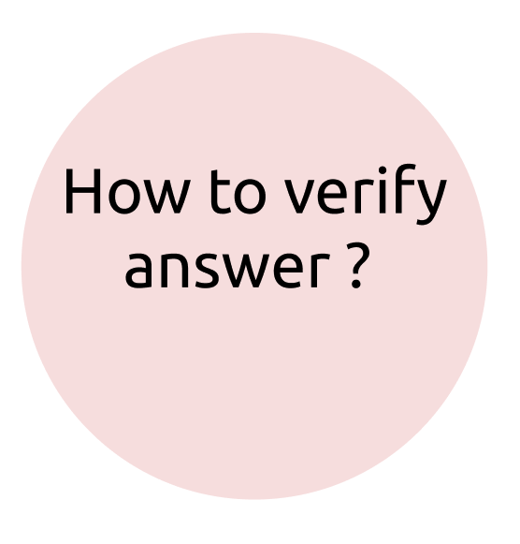
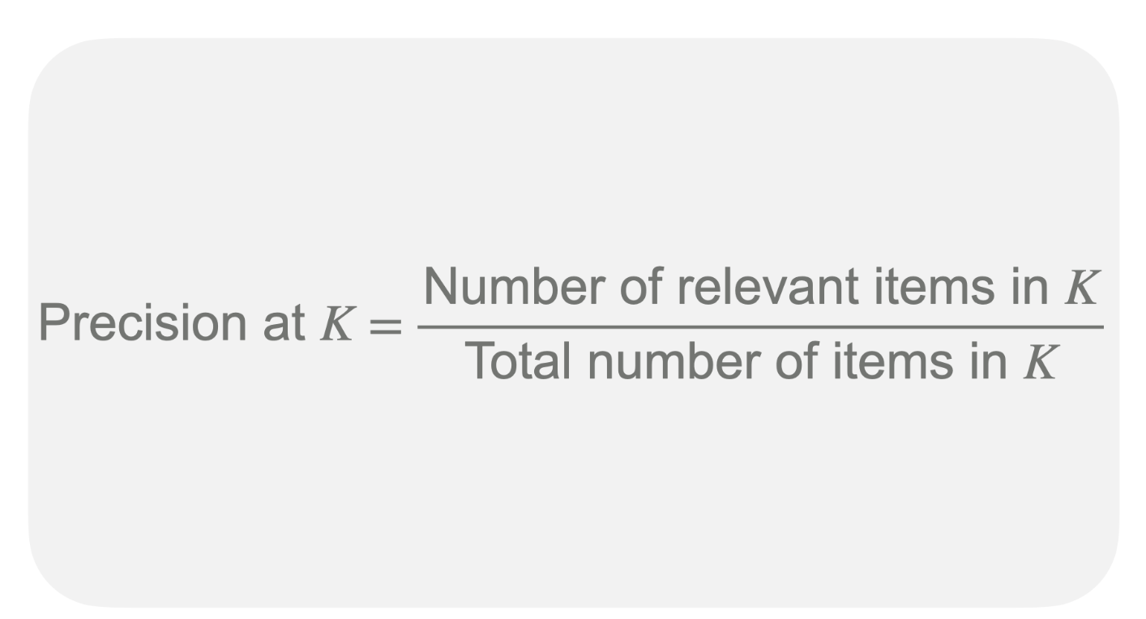
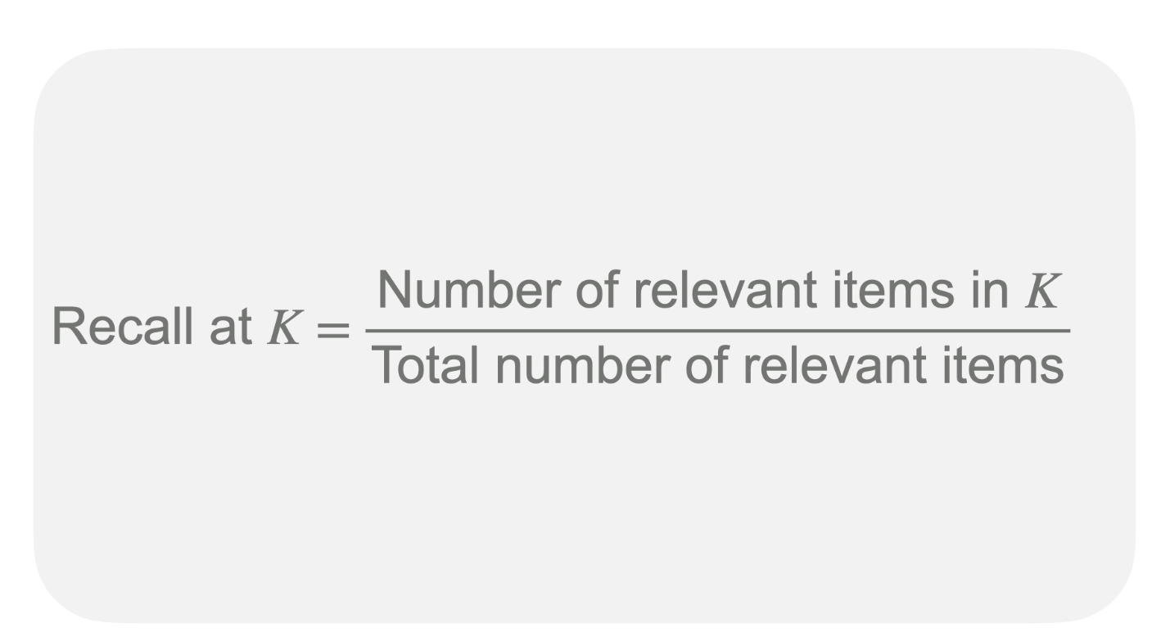
III.5. Evaluation
Retriever Evaluation: Precision & Recall @ k
Precision @k
How many retrieved documents are relevant ?
Recall @k
How many relevant documents are retrieved ?

Slide 30
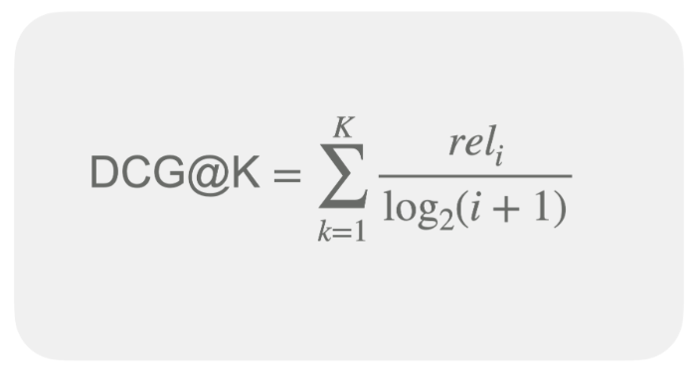
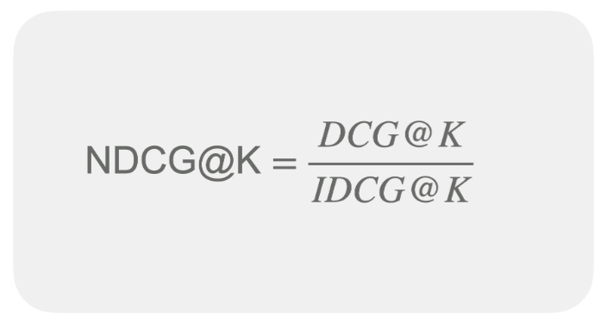
III.5. Evaluation
Retriever Evaluation : NDCG
NDCG can take values from 0 to 1.
NDCG equals 1 in the case of ideal ranking when items are perfectly sorted by relevance.
NDCG equals 0 when there are no relevant objects in top-K.
NDCG can be between 0 and 1 in all other cases. The higher the NDCG, the better.
Notes:
Le plus un doc importnat est bas le moins il a de poids
IDCG est le parfait ranking

Slide 31
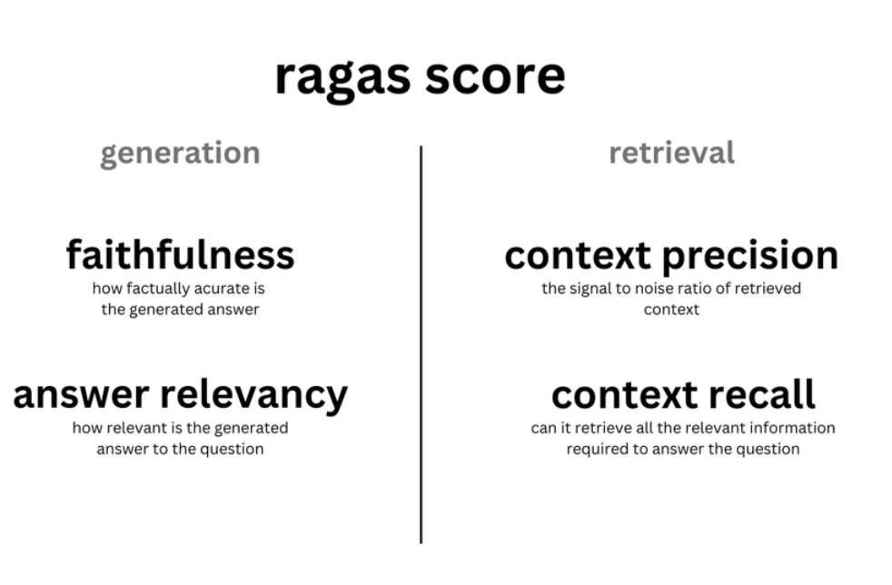
III.5. Evaluation
Answer Evaluation: LLM As a judge
Ask an LLM to evaluate answer quality:
Does my answer answer to the question ?
Does my answer used information from the context ?
Does my answer give enough facts ?
…
BLEU, ROUGE, Perplexity are not ideal for RAG use case.
Evaluating answers in RAG is not easy
RAGAS
Notes:
Le plus un doc importnat est bas le moins il a de poids
IDCG est le parfait ranking

Slide 32
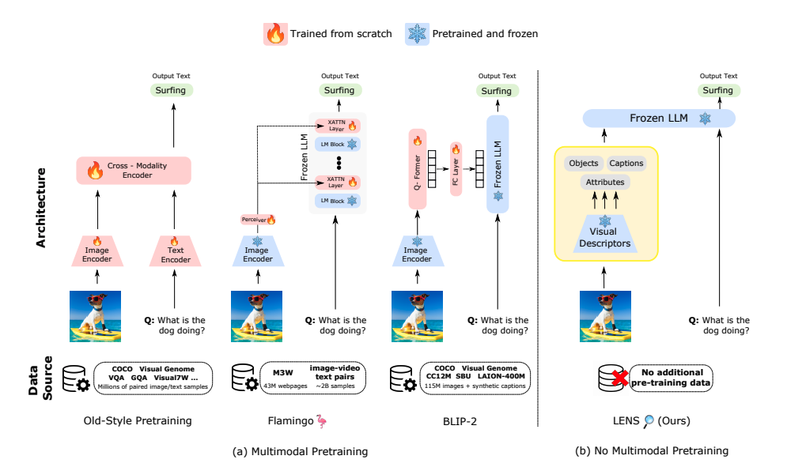

III.6. Multimodal RAG
Multimodal
Multimodal LLM: LLM capable of processing and understanding multiple types (or “modes”) of input data, such as text, images, audio, video, and other sensory inputs, in a unified manner.
Exemple: GPT 4o, Gemini 1.5, Qwen2- VL
Berrios & Al, 2023, Towards Language Models That Can See: Computer Vision Through the LENS of Natural Language
Notes:
Le plus un doc importnat est bas le moins il a de poids
IDCG est le parfait ranking

Slide 33


III.6. Multimodal RAG
Multimodal: Qwen2- VL
Outperform GPT 4o on most of the benchmarks
Multimodal Rotary Position (M-ROPE): “By deconstructing the original rotary embedding into three parts representing temporal and spatial (height and width) information，M-ROPE enables LLM to concurrently capture and integrate 1D textual, 2D visual, and 3D video positional information.”
Berrios & Al, 2023, Towards Language Models That Can See: Computer Vision Through the LENS of Natural Language
Notes:
Le plus un doc importnat est bas le moins il a de poids
IDCG est le parfait ranking

Slide 34

III.6. Multimodal RAG
Rotary Embedding (ROPE)
Rotary Position Embedding, or RoPE, is a type of position embedding which encodes absolute positional information with rotation matrix and naturally incorporates explicit relative position dependency in self-attention formulation.
Unlike traditional position embeddings, which add fixed vectors to represent positions, RoPE encodes positional information directly into the attention mechanism by rotating the query and key vectors in the Transformer architecture. This approach allows the model to better handle long-range dependencies while maintaining the flexibility of the attention mechanism.
Properties:
Flexibility of being expand to any sequence lengths
Decaying inter-token dependency with increasing relative distances
Capability of equipping the linear self-attention with relative position encoding.
Su & AL, 2023, RoFormer: Enhanced Transformer with Rotary Position Embedding
Notes:
Le plus un doc importnat est bas le moins il a de poids
IDCG est le parfait ranking

Slide 35

III.6. Multimodal RAG
Multimodal RAG
Option 1: Store raw image using multimodal embedding. Retrieve images based on multimodal embedding similarity. Provide the raw image to the generator.
Option 2: Store the summary of the image using a multimodal LLM. Retrieve images based on its summary embedding. Provide the summary to the generator.
Option 3: Store the image and its summary using a multimodal LLM. Retrieve images based on its summary embedding. Provide the image to the generator.
LangChain, Multi-Vector Retriever for RAG on tables, text, and images
Notes:
Le plus un doc importnat est bas le moins il a de poids
IDCG est le parfait ranking

Slide 36

III.6. Multimodal RAG
Multimodal RAG
Yasunaga & Al, 2023, Retrieval-Augmented Multimodal Language Modeling
Notes:
Le plus un doc importnat est bas le moins il a de poids
IDCG est le parfait ranking

Slide 37

III.7. SOTA RAG architectures
Self-RAG
Generates multiple possible response segments in parallel, utilizing the retrieved documents as context.
The model ranks the generated segments based on their critique scores, selecting the most accurate and relevant segment as the final output.
This selection process ensures that the response is both factually correct and contextually appropriate.
Asai & Al, 2023, Self-RAG: Learning to Retrieve, Generate, and Critique through Self-Reflection
Ahmed, 2024, SELF-RAG (Self-Reflective Retrieval-Augmented Generation): The Game-Changer in Factual AI Generation [Blog]
Notes:
Le plus un doc importnat est bas le moins il a de poids
IDCG est le parfait ranking

Slide 38


III.7. SOTA RAG architectures
RAPTOR
RAPTOR recursively summarizes retrieved documents. Instead of processing the full text of multiple documents directly, it creates concise summaries that retain the most important information at each recursive step.
This hierarchy of summaries reduces the amount of information that needs to be processed while preserving the context and key facts from the original documents.
Sarthi & AL, 2024, RAPTOR: Recursive Abstractive Processing for Tree-Organized Retrieval
Ahmed, 2024, SELF-RAG (Self-Reflective Retrieval-Augmented Generation): The Game-Changer in Factual AI Generation [Blog]
Notes:
Le plus un doc importnat est bas le moins il a de poids
IDCG est le parfait ranking

Slide 39

III.7. SOTA RAG architectures
Corrective RAG (CRAG)
Add a retrieval evaluator based on the quality of retrieved sources
If sources are considered as incorrect, or ambiguous, augment or replace the context by a Web Search query
Yan & Al, 2024, Corrective Retrieval Augmented Generation
Notes:
Un seul choix est tiré correct ambiguous ou incrorrect pour tous les docs
Si ils sont tous au dessus d’un seuil , aucun au dessus vs entre les deux

Slide 40

III.7. SOTA RAG architectures
GraphRAG
The LLM processes the entire private dataset, creating references to all entities and relationships within the source data, which are then used to create an LLM-generated knowledge graph.
This graph is then used to create a bottom-up clustering that organizes the data hierarchically into semantic clusters. This partitioning allows for pre-summarization of semantic concepts and themes, which aids in holistic understanding of the dataset.
At query time, both of these structures are used to provide materials for the LLM context window when answering a question.
Microsoft, 2024, GraphRAG: Unlocking LLM discovery on narrative private data
Notes:
Le plus un doc importnat est bas le moins il a de poids
IDCG est le parfait ranking

Slide 41
III. Conclusion
Conclusion
Simple RAG: Encodes document content into a vector store, enabling quick retrieval of relevant information to enhance model responses.
Context Enrichment: Adds surrounding context to each retrieved chunk, improving the coherence and completeness of the returned information.
Multi-faceted Filtering: Applies various filtering techniques (metadata, similarity thresholds etc.) to refine and improve the quality of retrieved results.
Fusion Retrieval: Combines vector-based similarity search with keyword-based retrieval to improve document retrieval.
Intelligent Reranking: Reassesses and reorders initially retrieved documents to ensure that the most pertinent information is prioritized for subsequent processing.
Query Transformation: Modifies or expands the original query with query rewriting, step-back prompting and sub-query decomposition.
Hierarchical Indices: First identifies relevant document sections through summaries, then drills down to specific details within those sections.
Hypothetical Questions: HyDE transforms queries into hypothetical documents that contain answers, bridging the gap between query and document distributions in vector space.
Choose Chunk Size: Selects an appropriate fixed size for text chunks to balance context preservation and retrieval efficiency.
Semantic Chunking: Unlike traditional methods that split text by fixed character/word counts, semantic chunking creates more meaningful, context-aware segments.
Context Compression: Compresses and extracts the most pertinent parts of documents in the context of a given query.
Explainable Retrieval: Not only retrieves relevant documents based on a query but also provides explanations for why each retrieved document is relevant.
Retrieval w/ Feedback: Utilizes user feedback on the relevance and quality of retrieved documents and generated responses to fine-tune retrieval and ranking models.
Notes:
Le plus un doc importnat est bas le moins il a de poids
IDCG est le parfait ranking

Slide 42
III. Conclusion
Conclusion
Adaptive Retrieval: Classifies queries into different categories and uses tailored retrieval strategies (factual, analytical, contextual etc.) for each, considering query context and preferences.
Iterative Retrieval: Analyzes initial results and generates follow-up queries to fill in gaps or clarify information.
Ensemble Retrieval: Applies different embedding models or retrieval algorithms and uses voting or weighting mechanisms to determine the final set of retrieved documents.
Graph RAG= Retrieves entities and their relationships from a knowledge graph relevant to the query, combining with unstructured text for more informative responses.
Multimodal: Integrates models that can retrieve and understand different data modalities, combining insights from text, images, and more.
RAPTOR: Uses abstractive summarization to recursively process and summarize retrieved documents, organizing the information in a tree structure for hierarchical context.
Self RAG: Multi-step process integrating decision, document retrieval, relevance filtering and generative feedback for more powerful model responses.
Corrective RAG: Dynamically evaluates and corrects the retrieval process, combining vector databases, feedback, and models to improve responses.
Few shot examples: Provides a few examples in the prompt to help the LLM understand the desired output
Notes:
Le plus un doc importnat est bas le moins il a de poids
IDCG est le parfait ranking

